Slide 1
ORCA in Google Wallet
Choice Business
Account Update

Slide 2
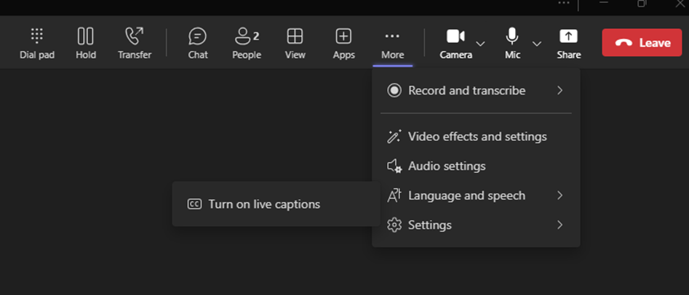



Open House Logistics
Your mic, camera, chat, and reactions have been disabled
To submit a question for Q&A use the link in the chat to the Microsoft Form – questions are moderated by staff and we will try to answer them at the end of the call
To turn on Closed Captions on your screen, follow these steps:
  1 Click on the three dots "More" button on the top of your screen
  2 Select "Language and Speech" from the drop down
  3 Click "Turn on live captions"

Slide 3
Agenda
Introduction to ORCA on Google Pay
What businesses need to know
New myORCA.com account management features
Timeline and next steps
Q&A

Slide 4

Introducing ORCA on Google Pay

Slide 5

Confidentiality statement
Please do not share this information outside your organization, it is confidential and for your internal use only prior to the public launch date.

Slide 6
Big-picture timeline
NDAs lifted by Google (for businesses, but not the public)
Google consumer launch & Business account opt in start date (TBA)
Issuing cards virtually in bulk
Product
development
Other future features
Other platform(s)
Longer term (no dates yet)
We are here

Slide 7
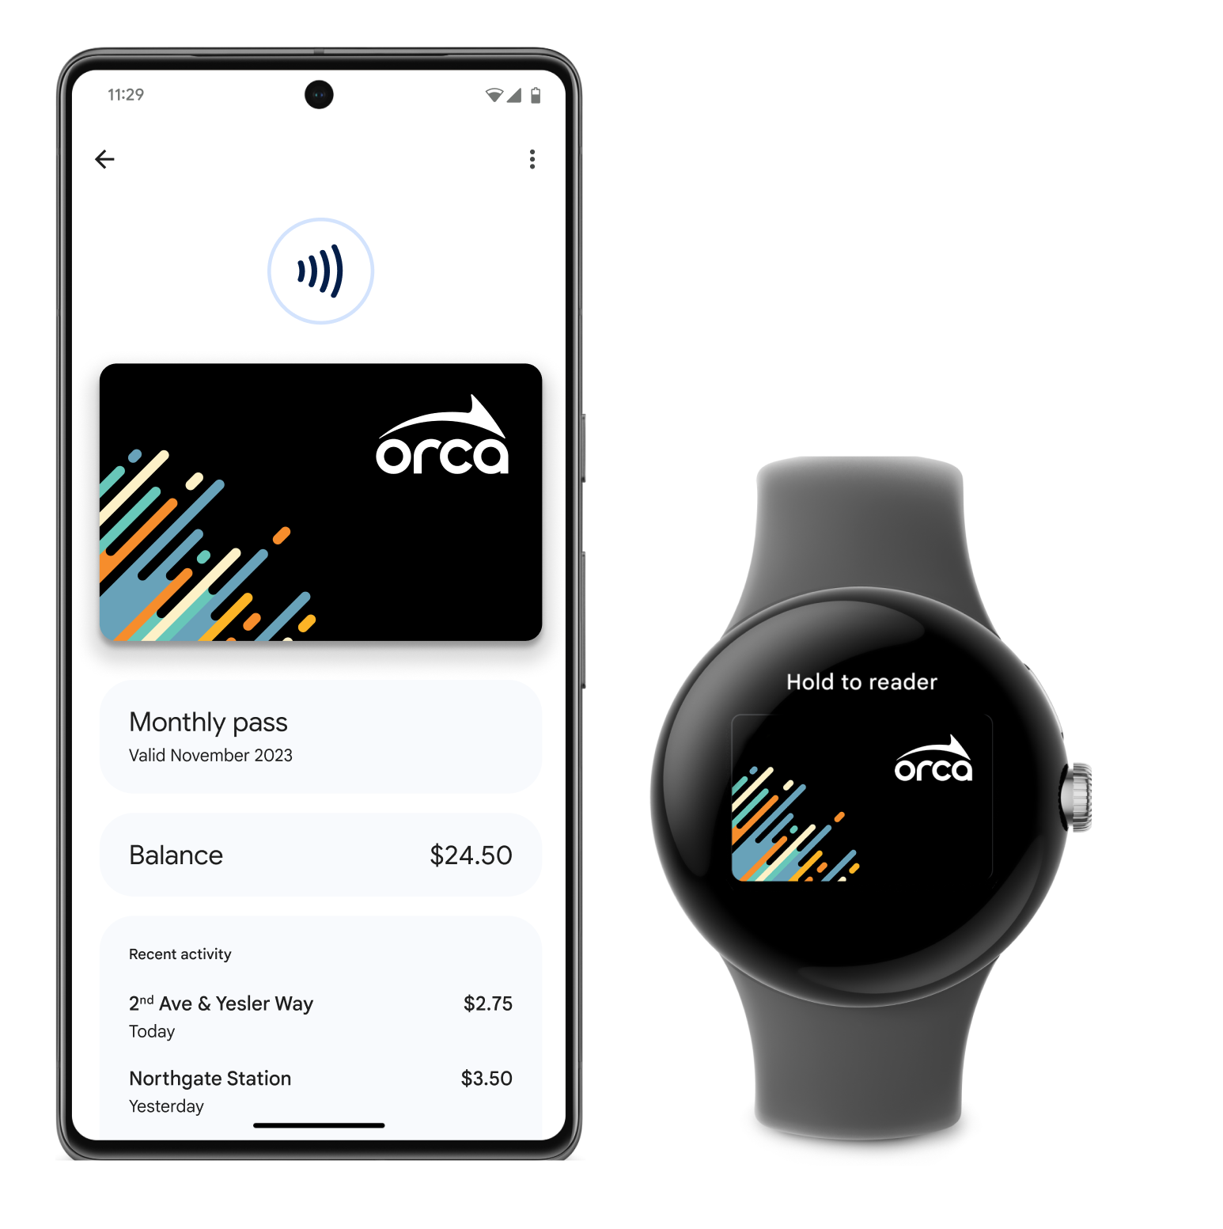
ORCA cardholder experience
Android phones (and Wear OS smartwatches) will work just like plastic ORCA card when paying for transit.
ORCA users can convert existing plastic card to digital or buy a new digital ORCA card.
This all happens in the Google Wallet app.

Slide 8
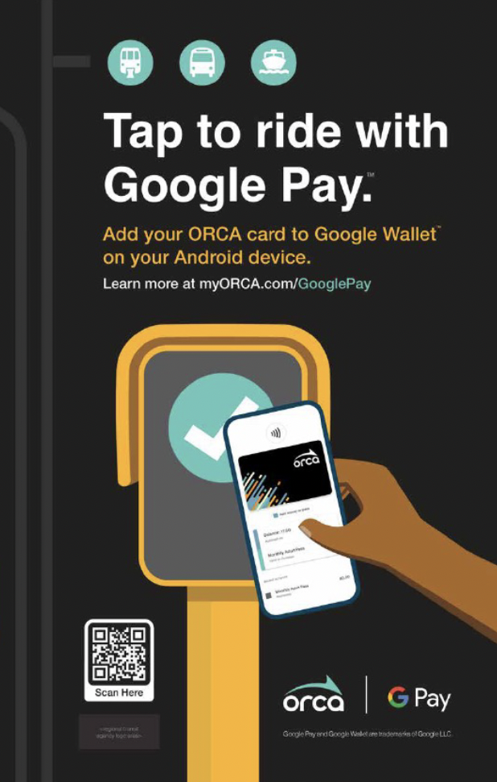
Benefits to ORCA cardholders
They have been asking for it!
Convenience of paying with their phone
ORCA users can get a new personal card instantly
Ability to add E-purse and Passes all within Google Wallet app
Integrates with Google Maps and Google Assistant

Slide 9


Slide 10
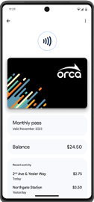
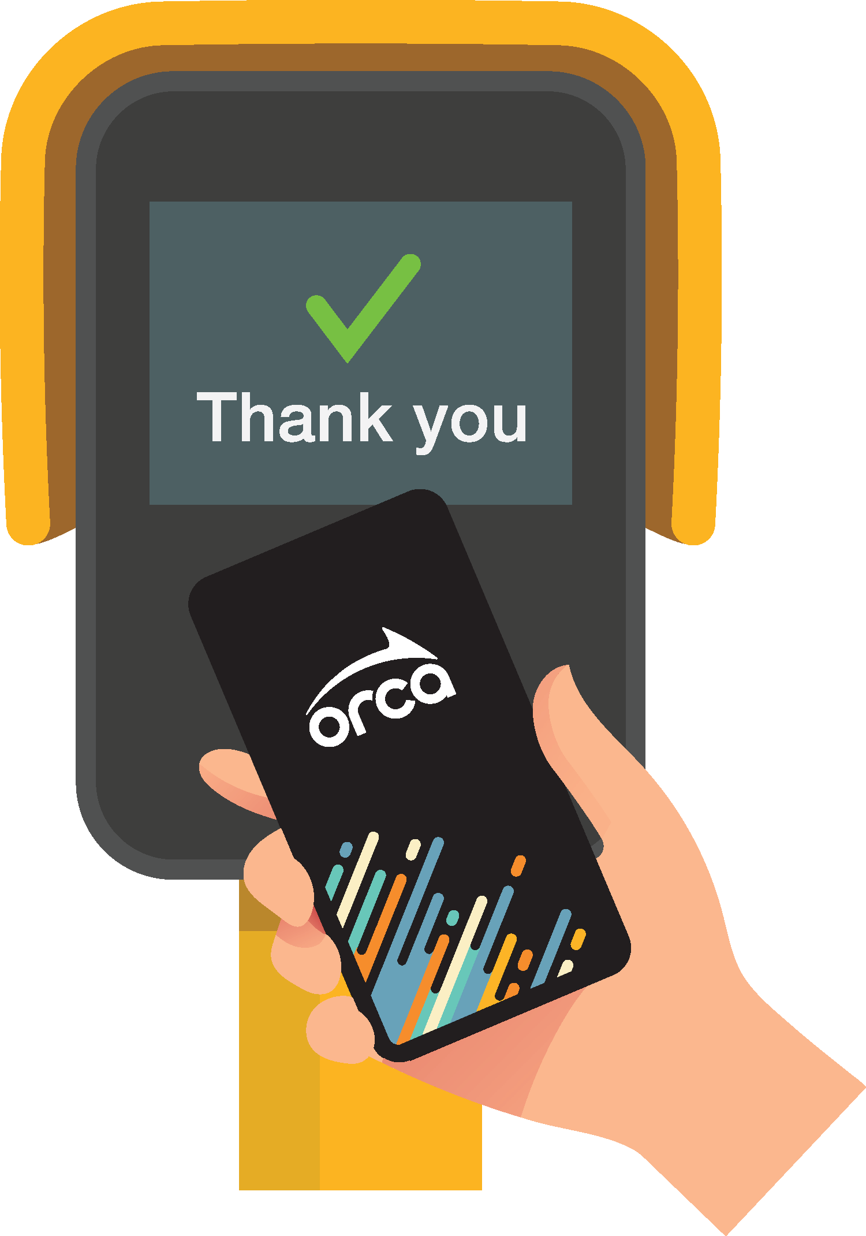
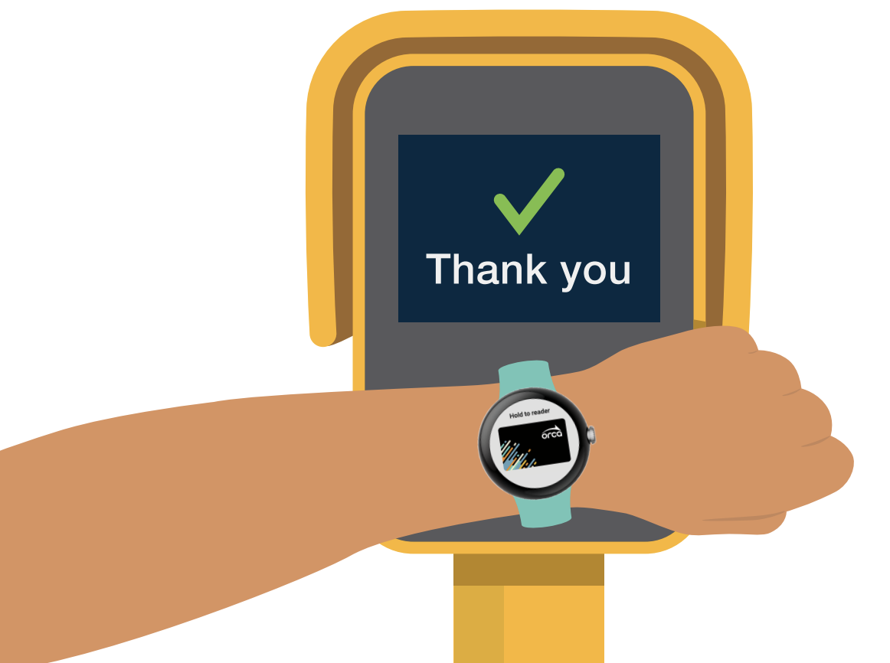
How to pay on transit
Unlock or Wake Up Your Device
You can set up your phone to allow for taps to occur by just waking up your phone screen without needing to unlock your phone every time.
Tap Your Android Phone
If the volume is on, you will hear a “boop” sound and see a green checkmark on the phone and card reader, indicating a successful tap. If you are riding the train, remember to tap off!
Tap your WearOS Device
If the volume of your watch is on you will hear a “boop” sound and see a green checkmark on the watch and card reader, indicating a successful tap. If you are riding the train, remember to tap off!

Slide 11

What businesses need to know

Slide 12
What to expect at launch
Its your choice
You will have the choice to opt in your account to this feature (by accepting new Business Account Terms of Use Agreement). If you do not wish to opt in, no action is required.
Continue issuing plastic cards
You will continue to issue plastic cards for new employees (whether you opt in or not)
Plastic to digital card replacement
Once you opt in, ORCA cardholders will be able to convert their plastic card to the Google Wallet on their own. When cards are converted, the plastic ORCA card will be permanently deactivated for security purposes, and a new digital ORCA card number will replace it.
Tools for managing digital cards
We will be providing new tools on myORCA.com for business accounts to manage digital ORCA cards, including notifications, new card number tracking, new data fields/filters, bulk actions, and card export reports. Loading and managing digital ORCA cards will work the same as plastic cards.

Slide 13
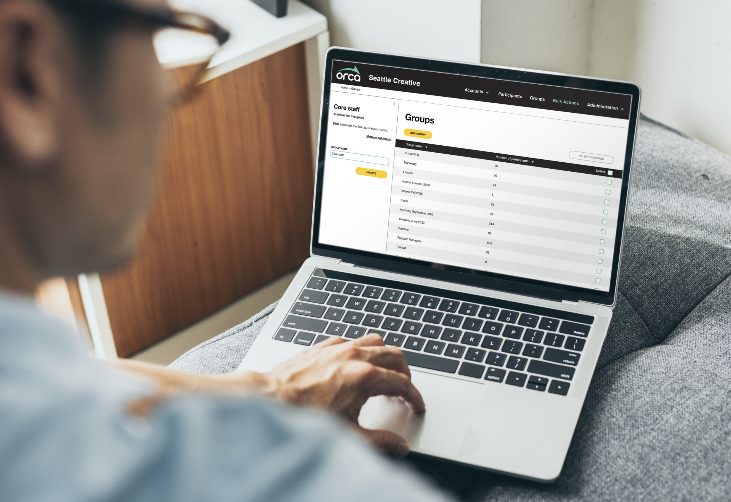
Support and tools for your business
Open house meetings (like this one)
User guides
FAQs
How-to videos
Employee communication tools

Slide 14
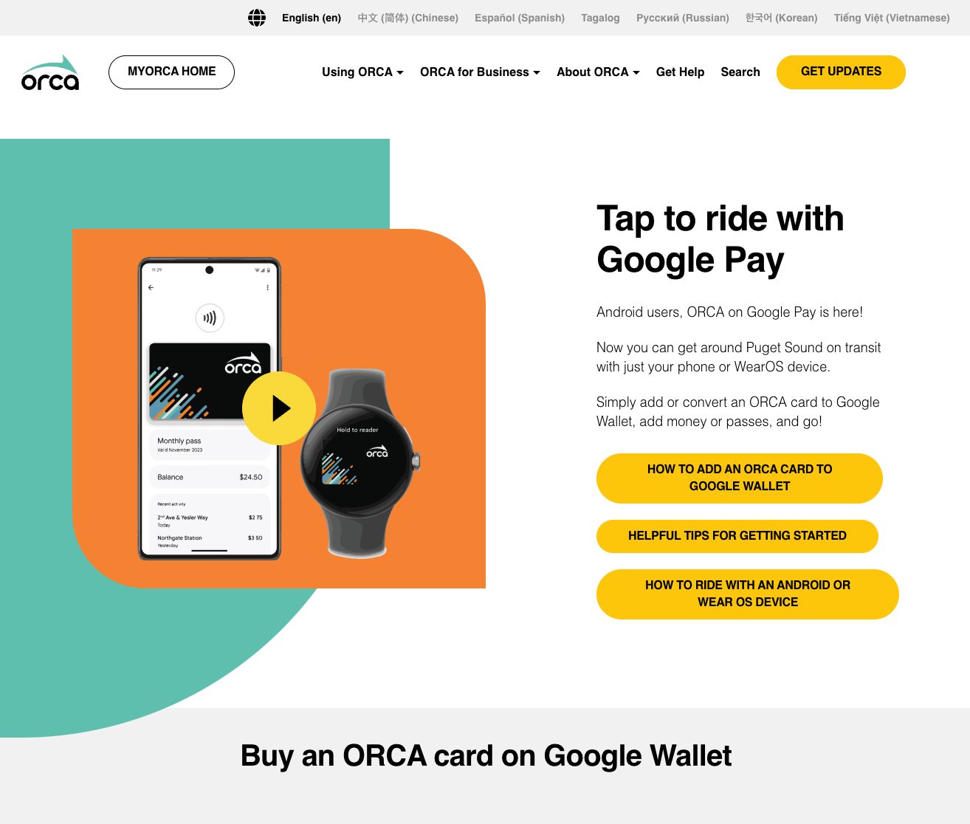
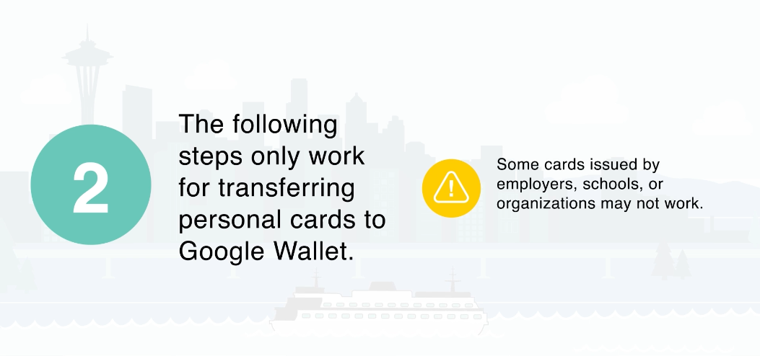
What we’re telling the public
Starting June 24, we will begin promoting ORCA on Google Pay, including a press release, social media, online advertising and on public transit.
We will be directing customers to https://info.myorca.com/googlepay/ to learn about the product and how to use it. (This link will be live June 24).
Public facing information includes clear notice indicating that cards issued by business accounts may not be converted in Google Wallet if the business has not opted in.

Slide 15
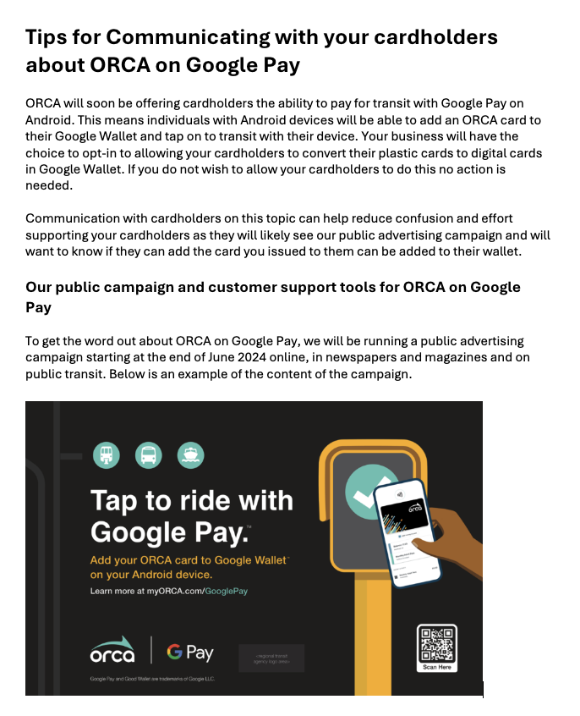
Communicating with Employees
We have created a guide for communicating with cardholders based on your plans:
  Opting in right away
  Still deciding or planning to opt in later
  Not planning to opt in

Slide 16

New account management features demonstration

Slide 17
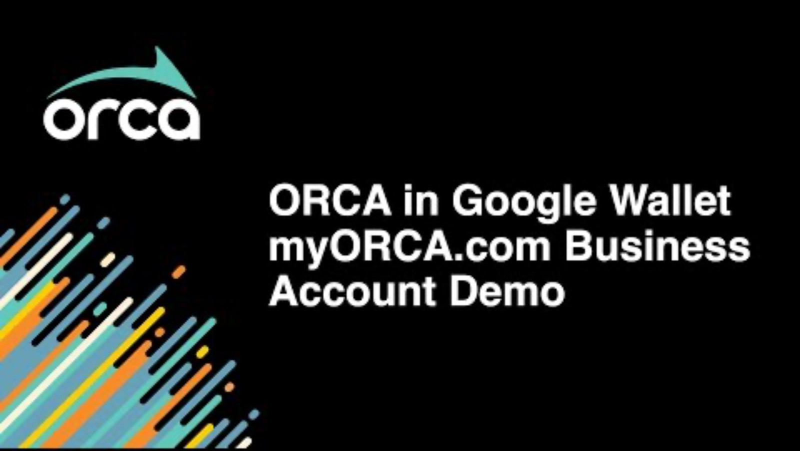

Slide 18

Timeline and next steps

Slide 19
What’s next
TODAY
LAUNCH DAY
AFTER LAUNCH
Our ORCA on Google Pay webpage for Choice Customers* is now live. Visit to see support and tools (Slide 13) as well as new Terms of Use for your review.
Public launch for individual cardholders. Launch will include a press release and a marketing campaign online and on the transit system.
You can start opting in on our ORCA on Google Pay webpage for Choice Customers* website and communicating with your cardholders.
*https://info.myorca.com/choice-googlepay/

Slide 20
How to opt in
01
02
03
04
Visit our ORCA on Google Pay webpage for Choice Customers* to review support information.
Fill out form on the website and accept the new Terms of Use.
Once you complete the form, your Business Account representative will complete the opt in process*
You will receive a confirmation email that your account has been enabled for Google Pay.
*https://info.myorca.com/choice-googlepay/
**Note: completion times may vary based on demand

Slide 21
Discussion and Q&A

Slide 22
Does our business have a choice to offer cardholders the ability to convert their cards?
Yes, you have the choice to opt in to this feature on your account. If you do not wish to do so, no action is required by you.

Slide 23
How do we opt in?
Visit https://info.myorca.com/choice-googlepay/ to review more information about ORCA on Google Pay, read the new Terms of Use and fill out the opt-in request form. Once you submit a form your Business Account representative will complete the process and notify you when your cardholders can start converting their plastic ORCA card to a digital ORCA card in Google Wallet.

Slide 24
When will this feature become available on other operating systems?
We are committed to bringing the convenience of mobile payments to all our customers. We will share any new information as it becomes available. To get the latest updates on ORCA, follow us on social media @TheORCACard or sign up for our monthly newsletter.

Slide 25
Can we reuse plastic cards that have been converted to digital ORCA cards in Google Wallet?
No, for security purposes when a plastic card is converted to a digital ORCA card in Google Wallet, it is permanently disabled. All E-Purse and pass products will be automatically moved to the new digital card.

Slide 26
Can a cardholder return a digital ORCA card to us for future use?
No, a digital ORCA card resides in the user's Google Wallet and cannot physically be returned to you for re-issuance. We can, however, transfer any active products on the digital ORCA card to another card on your business account.

Slide 27
Where will I find the new digital ORCA card numbers on my business account?
Both the original plastic ORCA card number and the new digital ORCA card number will be listed on your manage cards page in myORCA.com. You may also export a list of all cards on your account using the Export feature on that page. NOTE: some new columns and filter options will be visible before you opt in.

Slide 28
Still have questions?
We’ll now answer questions submitted using the linked Microsoft Form!
*You can continue to submit questions after the meeting - staff will follow-up with you after the meeting if you include your contact information.
Visit https://info.myorca.com/passport-googlepay/ to view our detailed Business Account FAQ for more answers.

Slide 29
What’s next
TODAY
LAUNCH DAY
AFTER LAUNCH
Our ORCA on Google Pay webpage for Choice Customers* is now live. Visit to see support and tools (Slide 13) as well as new Terms of Use for your review.
Public launch for individual cardholders. Launch will include a press release and a marketing campaign online and on the transit system.
You can start opting in on our ORCA on Google Pay webpage for Choice Customers* website and communicating with your cardholders.
*https://info.myorca.com/choice-googlepay/

Slide 30
How to opt in
01
02
03
04
Visit our ORCA on Google Pay webpage for Choice Customers* to review support information.
Fill out form on the website and accept the new Terms of Use.
Once you complete the form, your Business Account representative will complete the opt in process*
You will receive a confirmation email that your account has been enabled for Google Pay.
*https://info.myorca.com/choice-googlepay/
**Note: completion times may vary based on demand

Slide 31
Thank you.

